Slide 1

Pattern-Based Design and Thinking in Patterns
Software design patterns are reusable solutions to common problems. They can be implemented in various programming languages. Thinking in patterns helps engineers to understand the problem better, create more robust and flexible solutions, and collaborate efficiently.

Slide 2

Benefits of Pattern-Based Design
1
Code Reusability
Patterns promote code reuse, leading to efficient development and less redundancy.
2
Improved Collaboration
A common language for design solutions makes communication easier among team members.
3
Maintainability and Flexibility
Patterns ensure that software is easier to maintain and adapt to future changes.
4
Robust and Reliable Software
Patterns foster well-designed software that is more robust, reliable, and predictable.

Slide 3
Types of Design Patterns
Creational Patterns
Structural Patterns
Behavioral Patterns
These patterns provide ways to instantiate objects in a flexible and controlled manner. Examples include Factory, Abstract Factory, Singleton, Prototype, and Builder patterns.
These patterns help you to create more complex structures out of simpler objects. Some examples include Adapter, Bridge, Composite, Decorator, Facade, Flyweight, and Proxy patterns.
These patterns concern the communication and interaction between objects. Common examples include Chain of Responsibility, Command, Interpreter, Iterator, Mediator, Memento, Observer, State, Strategy, Template Method, and Visitor patterns.

Slide 4

The Shalloway and Trott Approach
1
Recognize the Problem
Identify the specific problem you're trying to solve.
2
Find the Pattern
Look for existing patterns that address the problem. Consult pattern catalogs and resources.
3
Apply the Pattern
Adapt and implement the chosen pattern to your specific context.
4
Document and Communicate
Document the implementation and share it with your team for clarity and consistency.

Slide 5

Thinking in Patterns
Thinking in patterns involves a shift in mindset. It moves away from focusing solely on individual code components and towards understanding the overall structure and behavior of a system.

Slide 6

Example: The Observer Pattern
Purpose
Define a one-to-many dependency between objects, where changes in one object automatically notify other dependent objects.
Example
A weather station (subject) notifying multiple subscribers (observers) about changes in temperature, wind speed, etc.
Benefits
Loose coupling between objects, flexibility in adding or removing observers, and improved maintainability.

Slide 7
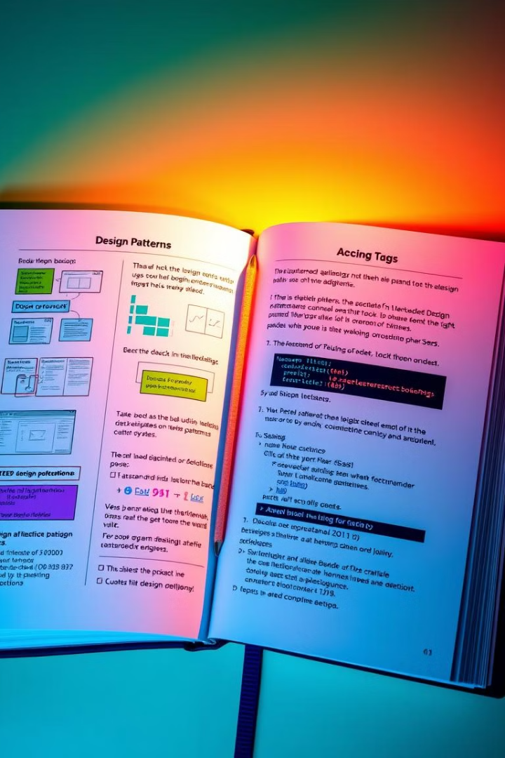
Pattern Catalogs and Resources
Several valuable resources are available online. Consult pattern catalogs like "Design Patterns: Elements of Reusable Object-Oriented Software" by Gamma, Helm, Johnson, and Vlissides (known as the "Gang of Four" or "GoF").

Slide 8

Conclusion
Understanding and applying design patterns is crucial for building efficient, flexible, and maintainable software. It enhances collaboration and promotes robust solutions. Continuously learning about new patterns and applying them to your projects can lead to better software design and development.

